Slide 1
MANAGEMENT INFORMATION SYSTEM
BIT 1201: INFORMATION MANAGEMENT

Slide 2
Content
An introduction to Information System
Meaning of Management Information System
Characteristic of MIS
Components of MIS
The aim of MIS
Types of MIS
Outputs of MIS
Benefits of MIS

Slide 3
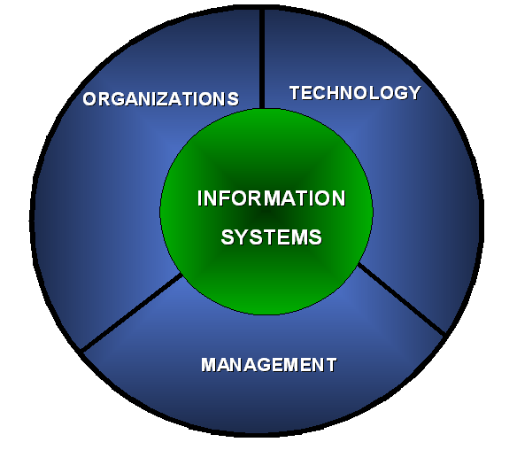

Meaning Of Information Systems
An information system is an organized combination of people, hardware, software, communications Networks and data resources that collects, transforms, and disseminates information in an organization.

Slide 4
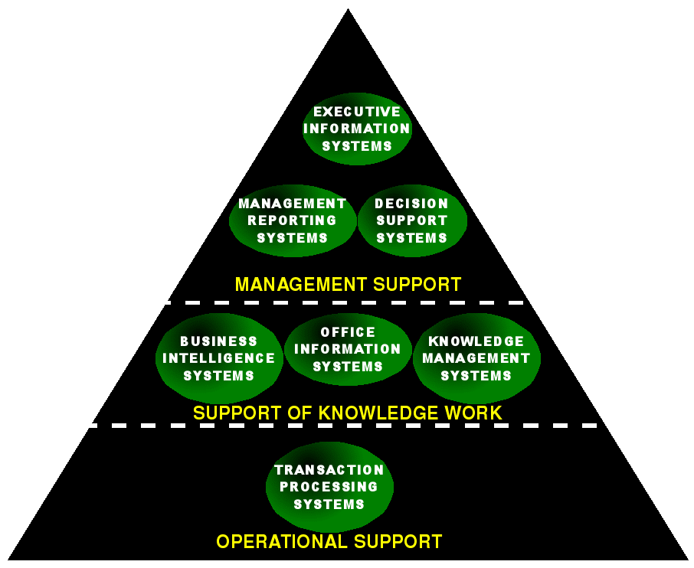
Types Of Information System

Slide 5

MANAGEMENT INFORMATION SYSTEM(MIS)
The MIS is defined as a system based on the database for the purpose of providing information to the people in the organization.

Slide 6
MANAGEMENT INFORMATION SYSTEM(MIS)
Management information systems are distinct from regular information systems in that they are used to analyze other information systems applied in operational activities in the organization. MIS involve three primary resources:
Technology,
information, and
People.
Management information systems are regarded to be a subset of the overall internal controls procedures in a business, which cover the application of people, documents, technologies, and procedures used by management accountants to solve business problems such as costing a product, service or a business-wide strategy.

Slide 7
Role Of MIS
The role of MIS in an organization can be compared to the role of heart in the body.
The information is the blood and MIS is the heart. In the body the heart plays the role of supplying pure blood to all the elements of the body including the brain.
The MIS plays exactly the same role in the organization.
The system ensures that an appropriate data is collected from the various sources, processed, and sent further to all the needy destinations.

Slide 8
Role Of MIS
The system is expected to fulfill the information needs of an individual, a group of individuals, the managers and the top management.
The MIS satisfies a wide rage of needs through a variety of systems such as Query Systems, Analysis Systems, Modeling Systems and Decision Support Systems.
The MIS helps in Strategic Planning, Management Control, Operational Control and Transaction Processing.

Slide 9
Characteristics of MIS
Management-oriented: The basic objective of MIS is to provide information support to the management in the organization for decision making.
Integrated: It means a comprehensive or complete view of all the subsystems in the organization of a company.
Information as a resource: Information is the major requirement of any MIS.

Slide 10
Characteristics of MIS
Common data flows: The integration of different subsystems will lead to a common data flow which will help in avoiding redundancy in data collection, storage and processing.
Heavy planning-element: The preparation of MIS is not a one or two day exercise. It usually takes 3 to 5 years and sometimes a much longer period.
Subsystem concept: When a problem is seen in 2 sub parts, then the better solution to the problem is possible.

Slide 11
Characteristics of MIS
Common database: This is the basic feature of MIS to achieve the objective of using MIS in business organizations.
Computerized: MIS can be used without a computer. But the use of computers increases the effectiveness and the efficiency of the system.
User friendly/Flexibility: An MIS should be flexible.

Slide 12
Features of MIS
Timeliness
Accuracy
Consistency
Completeness
Relevance

Slide 13
Elements of MIS
1) Marketing Research System (MRS)
Marketing research can be seen as the systematic and objective search for and analysis of data and information relevant to the identification and solution of any problem in the field of marketing.

Slide 14
Elements of MIS
2) Marketing Intelligence System (MIS)
The process of acquiring and analyzing information in order to understand the market (both existing and potential customers); to determine the current and future needs and preferences, attitudes and behavior of the market; and to assess changes in the business environment that may affect the size and nature of the market in the future.

Slide 15
Elements of MIS
3) Internal Record System (IRS)
Marketing managers depend on internal reports on orders, sales, prices, costs, inventory levels, receivables, payables etc. By analyzing this information, they can spot important opportunities and problems.

Slide 16
Elements of MIS
4)Decision Support System(DSS)
A decision support system (DSS) is a computer-based information system that supports business or organizational decision-making activities. DSSs serve the management, operations, and planning levels of an organization and help to make decisions, which may be rapidly changing and not easily specified in advance.

Slide 17
Aim of Management Information System
The main aim of MIS is to inform management and help them make informed decisions about management and the way the business is run.

Slide 18
Types Of IS
Transaction processing systems: These systems process a large volume of routine, recurring transactions.
Operations information systems: These systems gather comprehensive data, organize it and summarize it in a form that is useful for managers.
Decision support systems: These systems help mangers with the necessary information to make intelligent decisions.
Expert systems: They are meant to imitate humans in making decisions in a specific field.

Slide 19
Components of IS
1.Hardware
2.Software
3.Control
4.Databases and application programs
5.People
6.Telecommunications and Networks

Slide 20
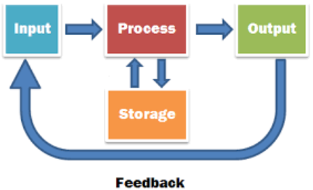
Cycle

Slide 21
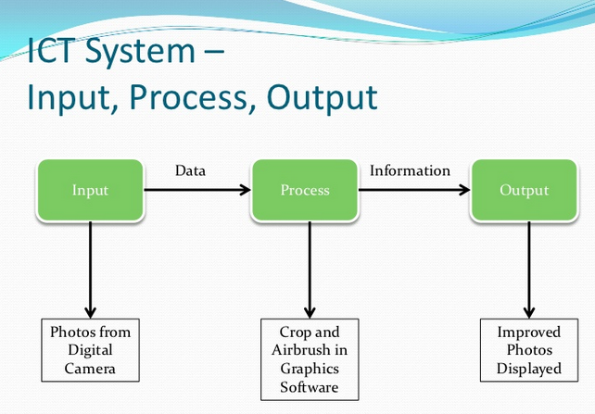

Slide 22
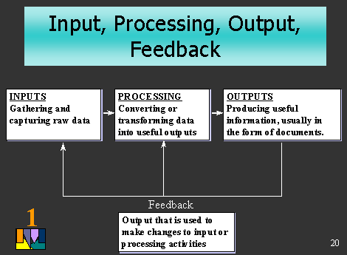

Slide 23
Outputs Of a MIS
Scheduled reports which are produced periodically, or on a Schedule (daily, weekly, monthly).
Key-indicator report which summarizes the previous day’s critical activities and also it is typically available at the beginning of each day.

Slide 24
Outputs Of a MIS
Demand report which gives certain information at a manager’s request.
Exception report which is automatically produced when a situation is unusual or requires management action.

Slide 25
Benefits of MIS
It improves personal efficiency.
İmproved productivity
It speeds up the progress of problems solving in an organization).
Increased data security
It facilitates interpersonal communication
It promotes learning or training.
It increases organizational control.

Slide 26
Benefits of MIS
It generates new evidence in support of a decision.
It creates a competitive advantage over competition.
It encourages discovery on the part of the decision maker.
It reveals new approaches to thinking about the problem space.
It helps to automate the Managerial processes.

